Slide 1
K-Nearest Neighbour Classifier (KNN)
Dr. Manju Venugopalan
Asst Professor (S. G)
Dept of CSE
Amrita School of Computing, Bengaluru

Slide 2
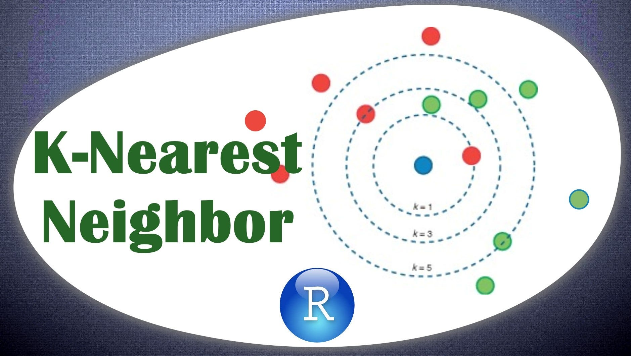

Slide 3
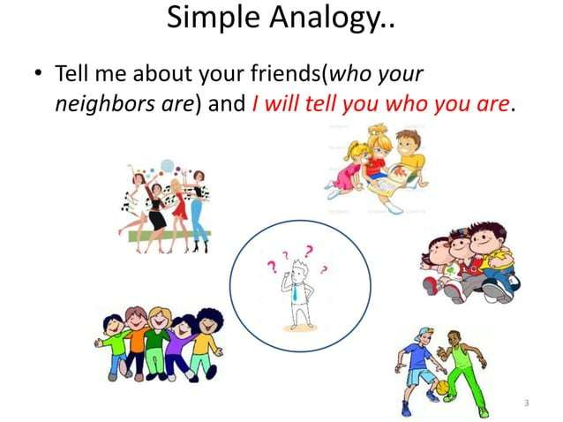

Slide 4
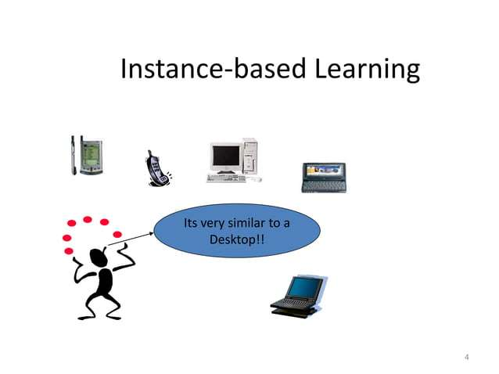

Slide 5
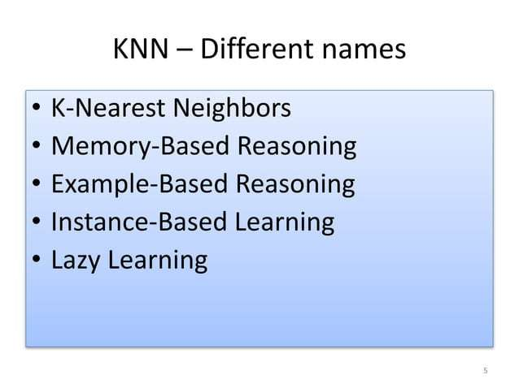

Slide 6
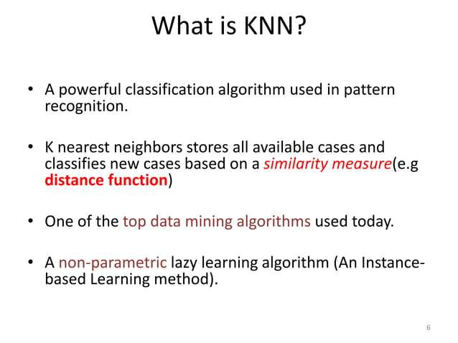

Slide 7
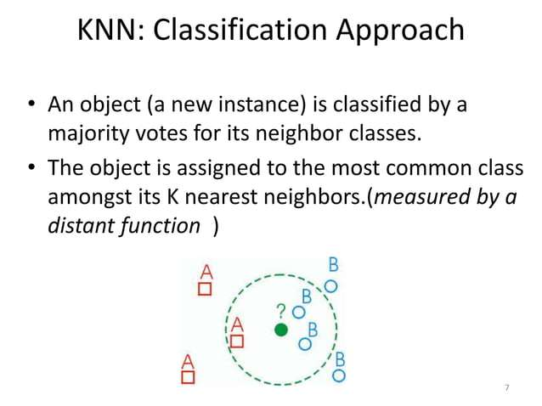

Slide 8
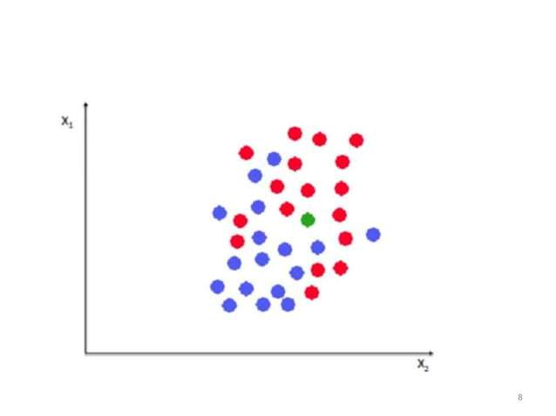

Slide 9
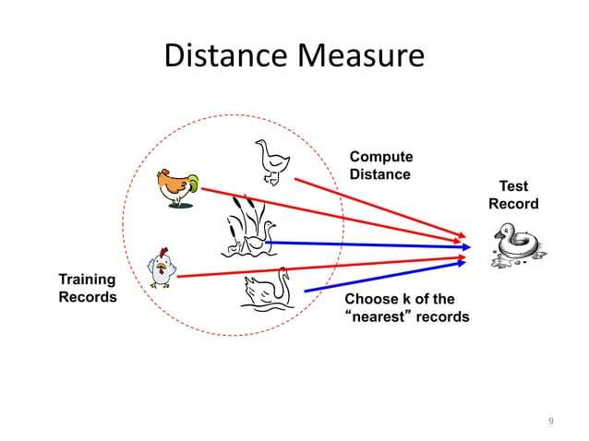

Slide 10
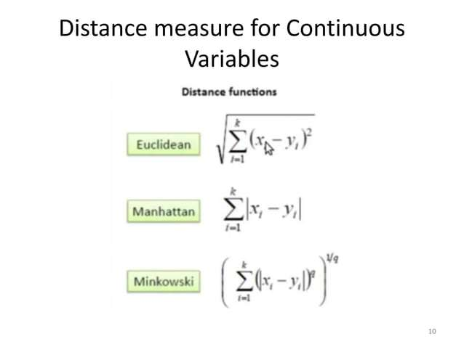

Slide 11
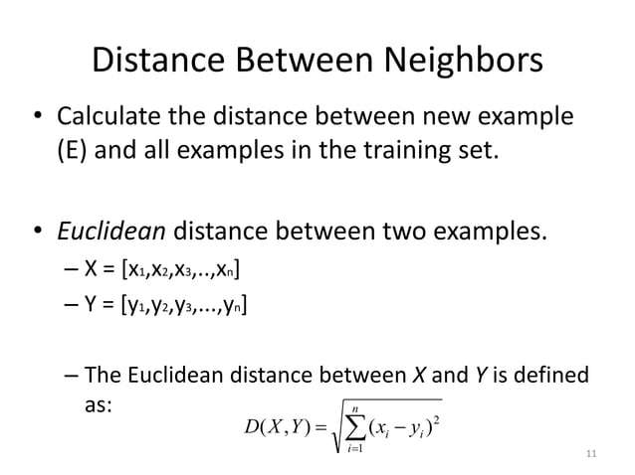

Slide 12
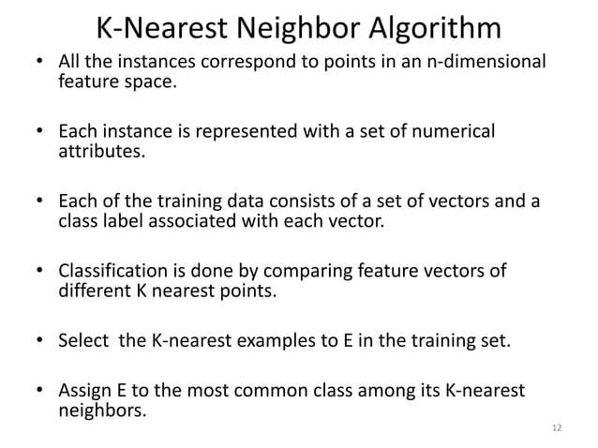

Slide 13
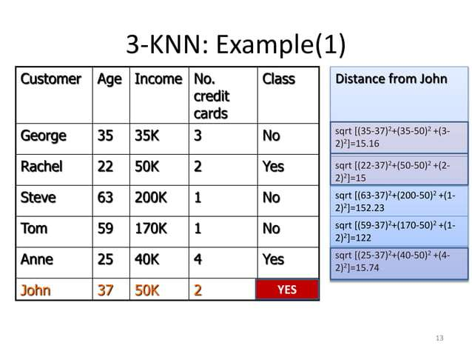

Slide 14
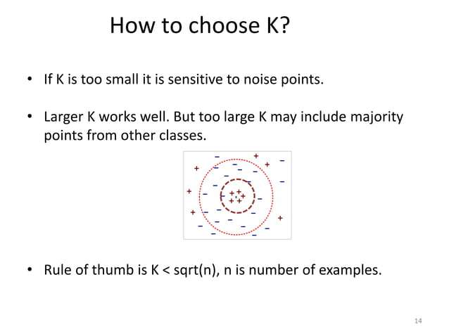

Slide 15
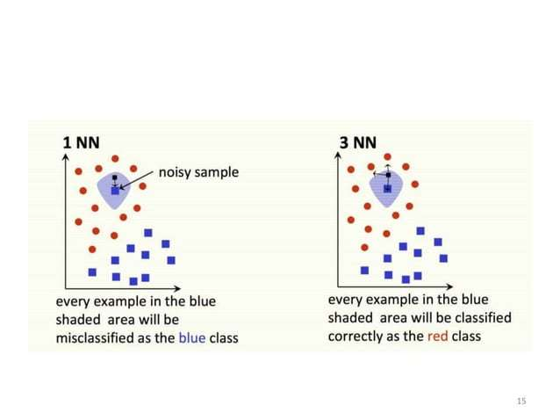

Slide 16
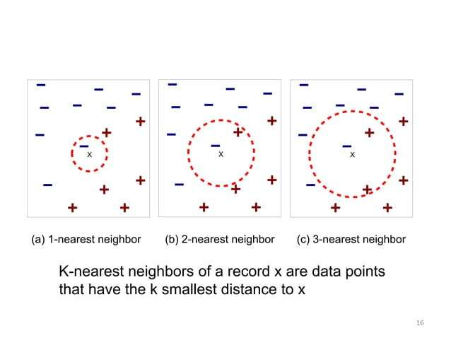

Slide 17
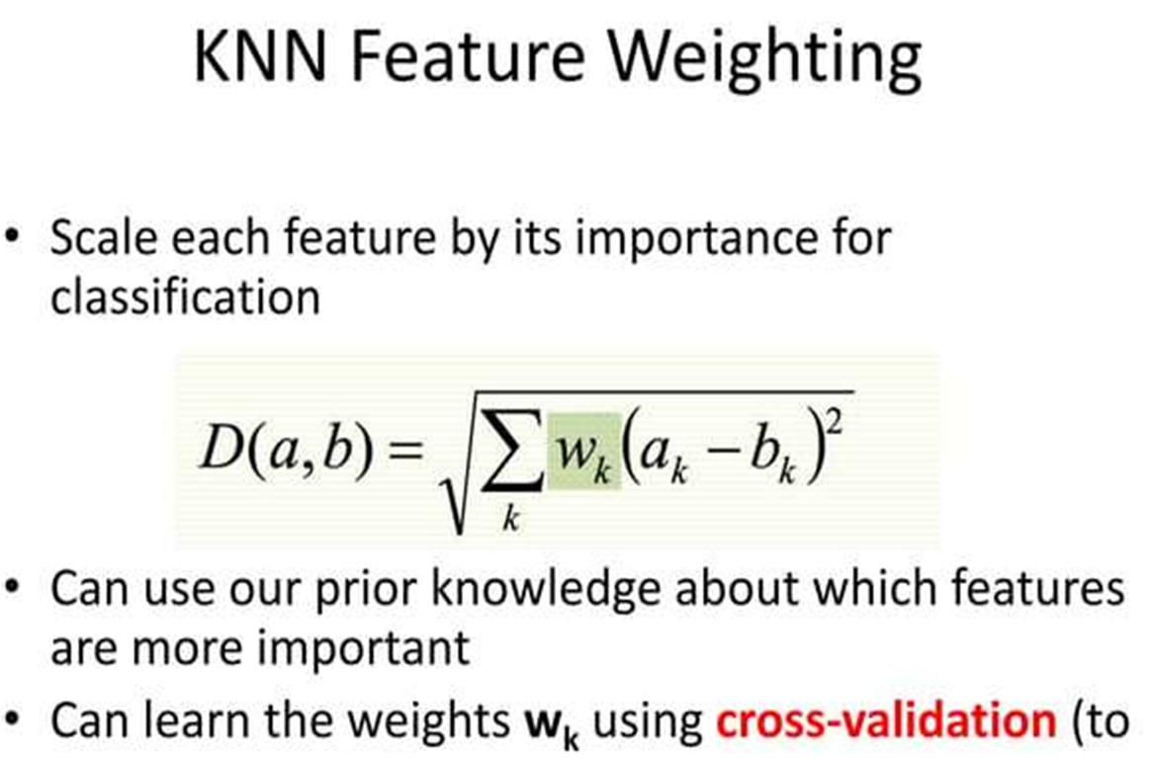

Slide 18
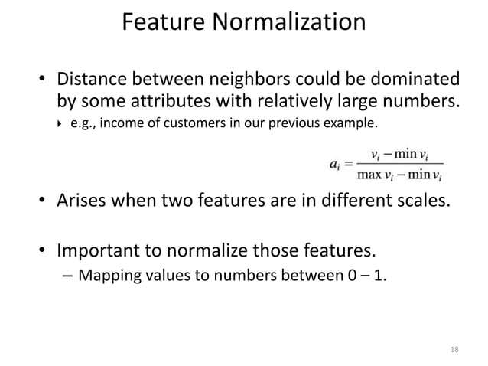

Slide 19
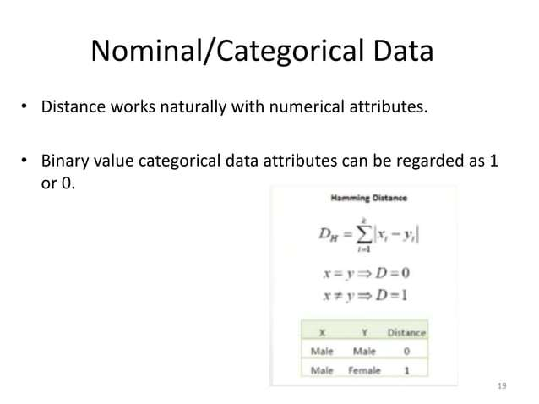

Slide 20
If attributes are non numeric?
COLOUR
compare the corresponding value of the attribute in tuple X1 with that in tuple X2 .
If the two are identical (e.g., tuples X1 and X2 both have the color blue), then the difference between the two is taken as 0.
If the two are different (e.g., tuple X 1 is blue but tuple X 2
is red), then the difference is considered to be 1.
Other methods may incorporate more sophisticated schemes for differential grading (e.g., where a larger difference score is
assigned, say, for blue and white than for blue and black).
9/2/2021
Machine Learning & Data Mining -15CSE401
20

Slide 21
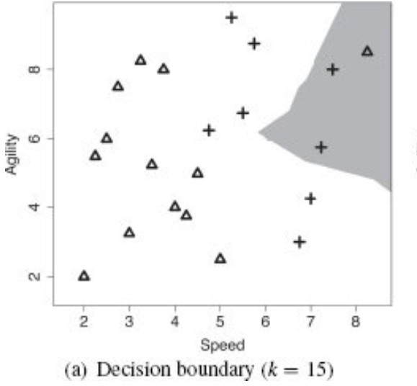
KNN on Imbalanced data
The risks associated with setting k to a high value are particularly acute when we are dealing with an imbalanced dataset.
as k increases, the majority target level begins to dominate the feature space

Slide 22
Distance-weighted nearest neighbor algorithm
When a distance weighted k nearest neighbor approach is used, the contribution of each neighbor to the prediction is a function of the inverse distance between the neighbor and the query x_{q}
Give greater weight to closer neighbor
1
𝑤 ≡
𝑑(𝑥_{𝑞}, 𝑥_{𝑖})
2
.

Slide 23
Issues with Distance-weighted knn
if the dataset is very imbalanced, then even with a weighting applied to the contribution of the training instances, the majority target level may dominate.
when the dataset is very large, which means that computing the reciprocal of squared distance between the query and all the training instances can become too computationally expensive to be feasible

Slide 24
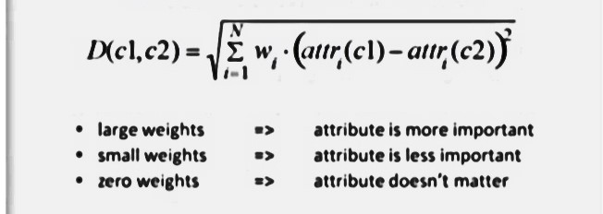
Improvements
Weighted Euclidean distance

Slide 25
Efficient Memory Search
if we are working with a large dataset, the time cost in computing the
distances between a query and all the training instances and retrieving the k nearest neighbors may be prohibitive.
use k-d tree,(k-dimensional tree),.
A k-d tree is a balanced binary tree in which each of the nodes in the tree
(both interior and leaf nodes) index one of the instances in a training dataset.
The tree is constructed so that nodes that are nearby in the tree index training instances that are nearby in the feature space

Slide 26
Another approach
speed up classification time include the use of partial distance calculations and editing the stored tuples.
Compute the distance based on a subset of the n attributes.
If this distance exceeds a threshold, then further computation for the given stored tuple is halted, and the process moves on to the next stored tuple.
The editing method removes training tuples that prove useless.
This method is also referred to as pruning or condensing because it reduces the total number of tuples stored.

Slide 27
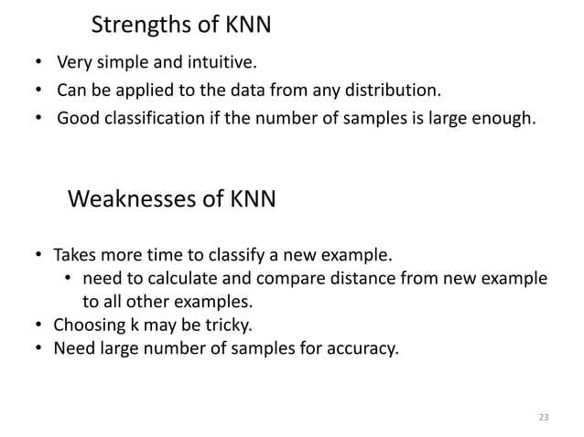

Slide 28
Thank you

